Slide 1
Assembly Language
Lab 6
2021/10/24

Slide 2
Objectives
Use mul(imul) to complete following code,
Create a program that can calculate multiplication from 1*1 to 9*9 and save the result into multiplication table, ninenine.
.data
result byte 81 DUP(?)
.code
start@0 PROC
[do something...]
exit
start@0 ENDP
END start@0

Slide 3
Hint
This lab class will use the Mul instruction, which will occupy the eax, ebx, and edx registers.
Please pay attention to the timing of the use of the temporary registers, and do not abuse the temporary registers so that no temporary registers can be used.

Slide 4
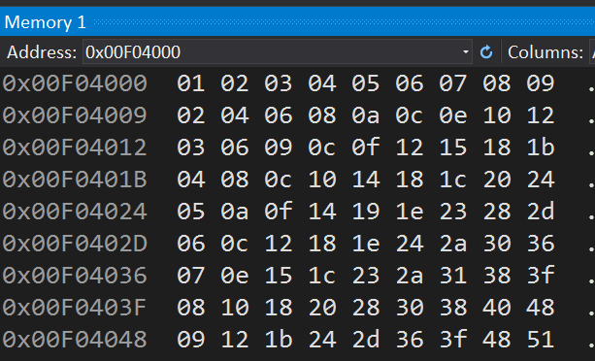
Program Result

Slide 5
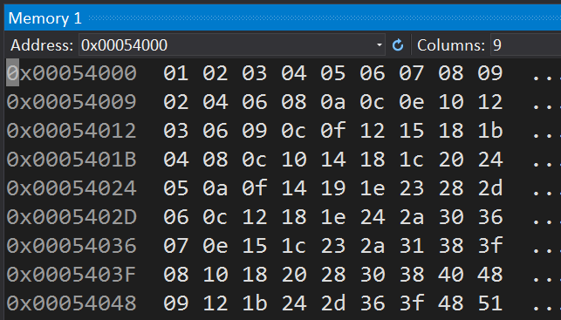
Memory Window
Select the number of data that can be displayed in a column (in Bytes)

Slide 6
Report
Due Date (2022/10/25)
Before 12:00
If you submit late, please send a letter to the teaching assistant, points will be deducted
Group Task
Compress(.zip,.rar) the following file with the name of the group ( e.g. lab6_01.zip)
Code(lab6_01.asm)
Report(lab6_01.doc or lab6_01.pdf)
Report Title
Group, name, student ID
Step by step of program execution flow, memory (register) status
Screenshots description, code Description
Reviews for the class, lesson learned, the tools we used, TA, etc

Slide 7
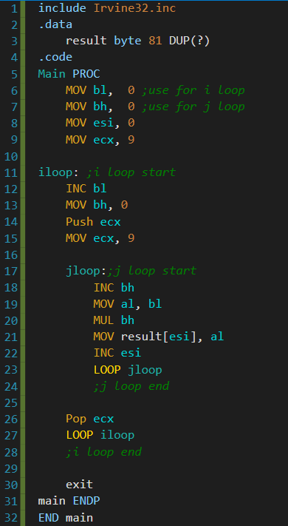









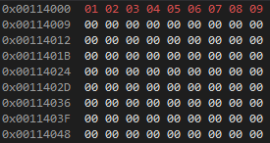







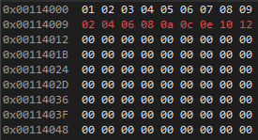


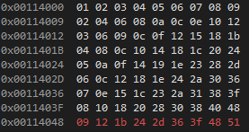
for(bl=1 ; bl<=9 ; bl++)
for(bh=1 ; bh<=9 ; bh++)
j loop
1st call
i loop
1st call
default value
default value
al doesn’t change because first call is 1*1
al before MUL and result are the same
2nd call
2nd call
bl increases by iloop
it doesn’t change in jloop
...
...

